Slide 1
Is follow up for lung cancer surgery evidence based in the UK?
A CRITICAL REVIEW OF PROTOCOLS

Slide 2
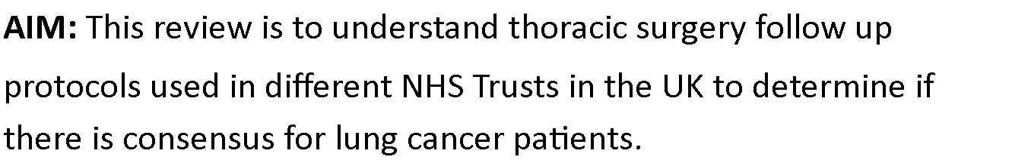

Barton, P; Bate, G; Dalrymple, P; Gomez, S; James, T; King, M; McAdam, J; Morley, J.

Slide 3

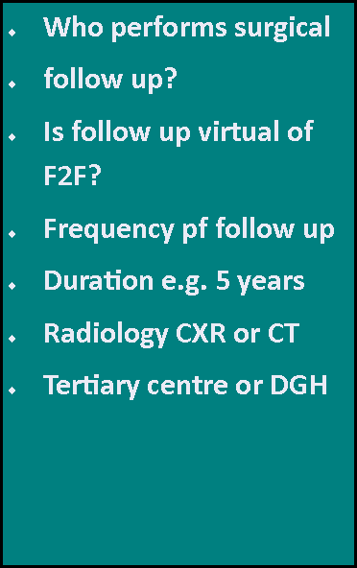
Literature review findings
An international literature search of the UK, USA, Brazil, Canada, France and Austria, for guidance on CT scan follow up and frequency following surgical resection for lung cancer. A search was performed using Google, CINAHL, using frameworks to formulate focused clinical questions and guide literature searches.
Key words: Lung cancer, Thoracic surgery, Lung resection, CT scan and follow up. This revealed 12 articles, from 1999-2022. Methods included Data collection, Systematic review and Retrospective and Comparative studies.
Key Points:• Majority of the literature supported CT as the imaging of choice.
• 7 pieces of evidence researched of imaging follow up for post thoracic surgery for lung cancer patients detected earlier asymptomatic recurrence, therefore in favour of CT based follow up.
• 1 study reviewed the impact of follow up on physical, psychological and lifestyle, with no content of CT based follow up.
• 1 study questioned different follow up regimes being stage dependant.

Slide 4
Analysis
Ten NHS Trusts provided lung cancer surgery follow-up protocols for the purpose of the review.
7/10 received were from tertiary centres.
6/10 Trusts provided a nurse led follow up service, the remainder were predominantly reviewed by Respiratory Physicians.
5/10 Trusts provided solely face to face appointments, with 3/10 providing a combination of virtual and Face to face.
Two Trusts had telephone follow up only. The frequency of the appointments varied between trusts in the first year, from 3-6 months.
The exception was Manchester NHSFT who reviewed high risk category patients on a 6-weekly basis for 2 years.
There were no notable differences of the follow up timescales between the Tertiary centres and District General Hospitals (DGH) or the lung cancer nurse specialists and Consultants.

Slide 5
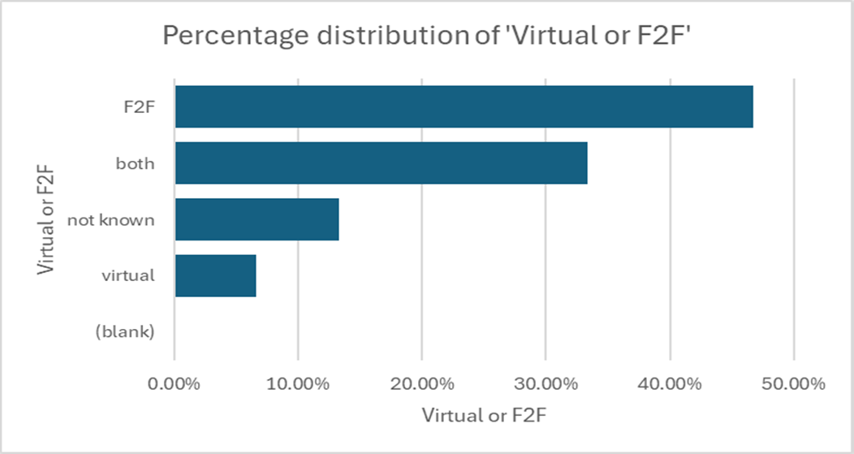
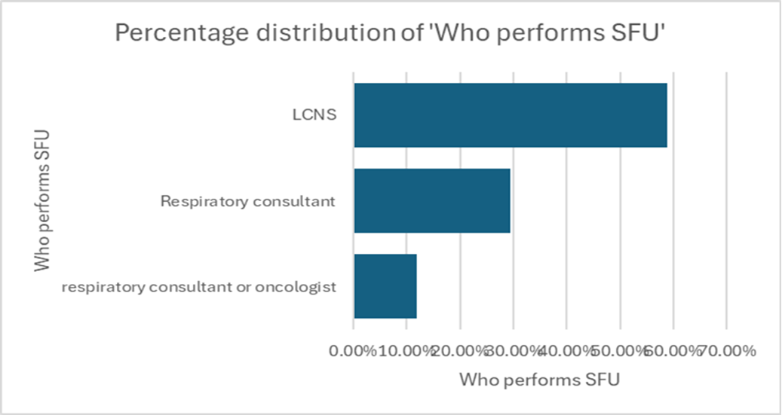
Analysis

Slide 6
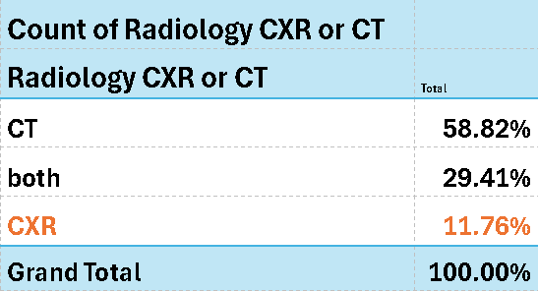
Findings
Our literature review highlighted there is limited evidence to support how lung cancer patients should be followed up post-surgery. Overall, the literature supports CT based imaging although no specific period is supported. From the protocols reviewed there were common themes identified. Post-surgical follow-up was predominantly nurse led, using face to face appointments, virtual appointments, or a mixture of both.
Frequency of follow-up varied between 3 and 8 months. Apart from one site, follow-up was consistently for 5 years.
Similarly, radiology modality predominantly used CT scan either solely or mixed with chest x-rays.

Slide 7
Implications for practice
Both the literature review and critical review of protocols highlight that further research would be beneficial. Analysing a wider population of protocols could help encourage a more standardised approach across the UK to ensure optimum care for patients.

