Slide 1
Patients’ Understanding of Follow-Up Post Curative Primary Lung Cancer Surgery
M. King, E. Wassell,
P. Barton, J. McAdam

Slide 2

Introduction
Although surgical treatment for primary non-small call lung cancer offers the best chance of cure, there are many cases (30% to 55%) that develop recurrence and dies of their disease (Uramoto and Tanaka 2014).
The recurrence free period appears on average to be 15.7 to 21 months (Sasaki et al 2014).
Follow-up after lung cancer surgery is therefore essential for;
Early detection of recurrence to benefit survival.
Identification of any new problems and symptom management.
Provision of information and psychological support.
How this information is discussed with patients and how they are supported following surgery is therefore of clinical importance.

Slide 3
Aim & Method
The Thoracic Surgery Group (TSG), a subgroup of the Lung Cancer Nursing UK conducted a multicentre survey to gain insight into patients' understanding of follow-up post curative primary lung cancer surgery.
Design
Between 01/08/2023 to 31/08/2023 every curative intent surgical patient was given a questionnaire to complete while attending follow-up clinic.
Setting
Three UK Thoracic outpatient centres.
Sample
Patients undergoing follow-up post curative primary lung cancer surgery (excluding carcinoids, recurrence).
Data Collection
155 questionnaires were distributed 148 returned. Information collected on demographics, smoking status, operation performed, follow-up period and exploration of understanding of follow-up.
Data analysis
Completed questionnaires were collated, compared and interpreted by the authors.

Slide 4
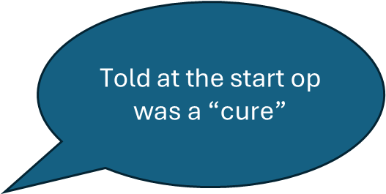
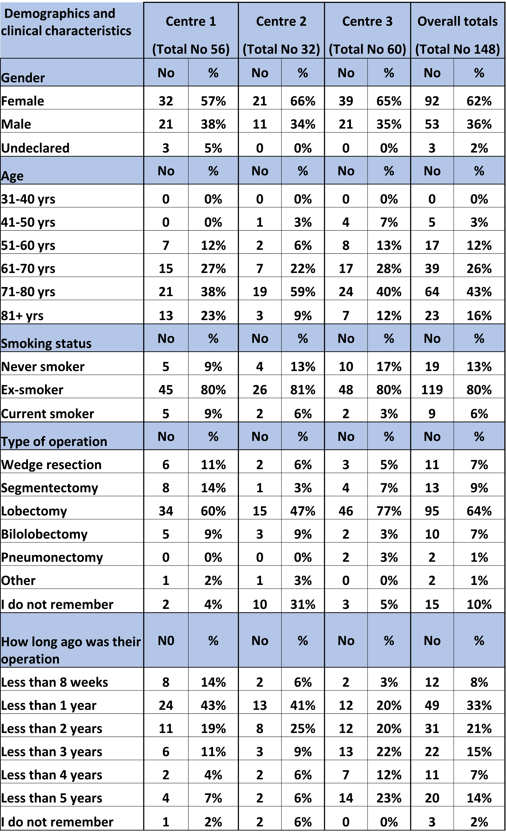
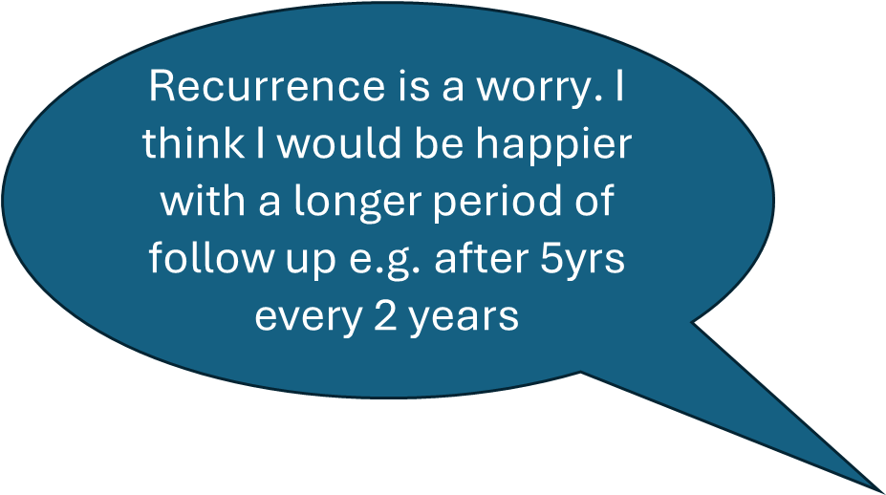






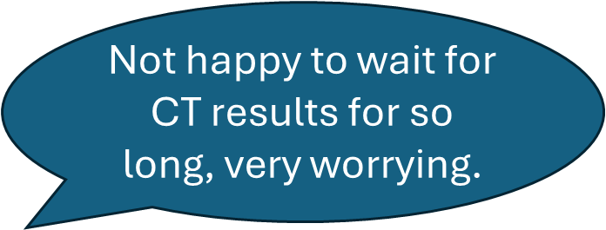


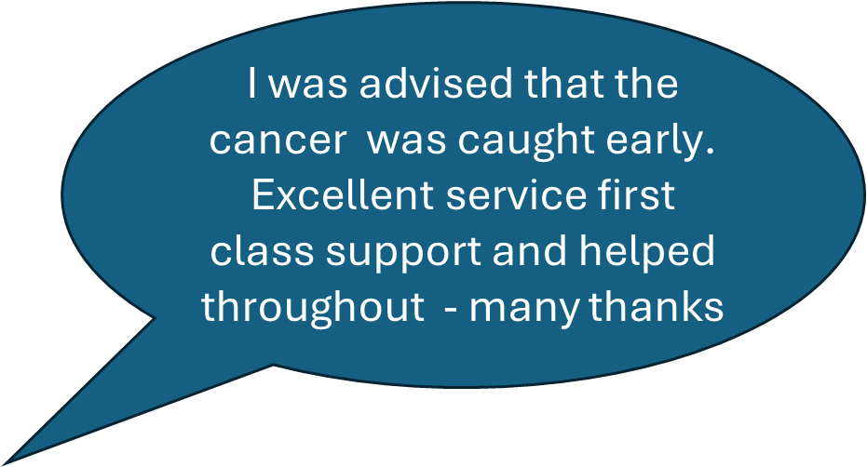

Results
96%
97%
72%
68%
67%
58%
57%
54%
45%
34%
9%

Slide 5
Implication for practice
Follow-up is an important part of patients on going care post primary lung cancer resection and healthcare professionals need to present information honestly and realistically, balancing “hope and uncertainty”, whilst conveying the information that a patient needs for them to participate in making an informed decision about their health care.
This study provides a snapshot into patients understanding of follow-up post primary lung cancer resection and has identified information areas for the Lung Cancer Nurse Specialist (LCNS) to consider:
* Necessity of follow-up
* Diagnosis/TNM stage and relevance
* Schedule and frequency of radiology (CXR/CT)
* Signs and symptoms suggestive of cancer recurrence
* Information to improve their ongoing health and wellbeing
* Key contact details
To address the knowledge gap patients, have regarding follow-up LCNSs will produce a patient information leaflet explain follow-up and encompassing the areas identified in this study.

Slide 6
References
Sasaki, H. Suzuki, A. Tatematsu, T. Shitara, A. Hikosaka, Y. Okuda, K. (2014) Prognosis of recurrent non-small cell lung cancer following complete resection. Oncology letters. 7(4) pp1300-1304 doi:10.3892/0l.2014.1861
Uramoto, H. Tanaka, F. (2014) Recurrence after surgery in patients with NSCLC. Translational Lung Cancer Research. 3(4) pp242-249 doi: 10.3978/j.issn.2218-6751.2013.12.05

